Slide 1











2019 Second International Conference on
Advanced Computational and Communication Paradigms
(ICACCP)
25 – 28 February, 2019
Technical Session #V Paper ID #. 1570507765
Brain Tumor Classification Using ResNet-101 Based Squeeze and Excitation Deep Neural Network
Swati Kanchan*, Lokesh Nandanwar*, Palash Ghosal, Ashok Bhadra, Jayasree Chakraborty, Debashis Nandi
Affiliations: NIT Durgapur, Medical College Kolkata, Memorial Sloan Kettering Cancer Center New York
swatikanchan070@gmail.com, lokeshnandanwar32@gmail.com

Slide 2

Paper Outline
1
Introduction
Block Diagram of Proposed Method
Dataset Description & Data Pre-processing
Proposed Methodology
Experimental Results & Discussions
Conclusion
Future Scope
References

Slide 3
Introduction
2
Brain tumors are diagnosed with 40,000 to 50,000 new people living in India, out of which 20% are children which amounts to over 2,500 children each year.
Due to the lack of adequate doctors, many districts and rural parts of India is covered by a single specialist, only a small proportion of the patients ﬁnd their way to the specialists.
Human assessment is one of the typical ways for brain tumor detection and classiﬁcation from MR images and it highly depends on the experience of radiologists who evaluate the characteristics of image slices thoroughly, also it is time-consuming and prone to error.

Slide 4
Introduction
2
In view of this, there is a good scope of developing a computerized diagnostic tool which will automatically detect and classify the brain tumors from the MR images and thus assist the medical practitioners.
In this work, a fully automatic methodology which can categorize brain tumors from a limited amount of data into different pathological types is proposed by using convolutional neural networks, which may release some workload of the doctors.
The squeeze and excitation [10] CNN model using Residual network architecture [11] was used for the classiﬁcation of tumors.

Slide 5

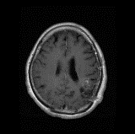
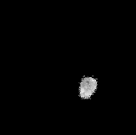
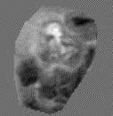



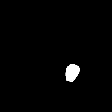

Block Diagram of Proposed Method
4
Augmented Images
Segmented Tumor (512 * 512)
Segmented Tumor (256 * 256)
SE-ResNet-101 CNN
T1 - weighted CE-MRI image
Normalized Image
One hot Encoded Output
Model
ROI
IN & ZC
[0, 1, 0]
b
Annotated Tumor Mask

Slide 6
Dataset Description
3
The Brain tumor database which has been collected in the year from 2005 to 2010, from Nanfang Hospital, Guangzhou, China, and General Hospital, Tianjin Medical University, China is used in this study.
The brain tumor dataset contained 3064 T1-weighted contrast-enhanced images from 233 patients with three kinds of brain tumor: meningioma (708 slices), glioma (1426 slices), and pituitary tumor (930 slices).
The dimension of each MRI slices were 512 × 512 pixels

Slide 7
Data Pre-processing
4
ROI segmentation - The annotated masks of the tumors, which contained labels ‘1’ for tumor region and ‘0’ for everything else, were provided in the brain tumor database. The exact tumors were extracted from the brain MRI samples by multiplying them pixel wise with the corresponding masks. Then tumor ROI images were resized and added zero padding to ﬁt into the particular input shape
Intensity Zero-centering and Normalization.
Data Augmentation - several combinations of transformations on the zero-centered, normalized, ROI segmented images of Glioma, Meningioma, and Pituitary tumor data were applied. The transformations were Flip, Rotate, Elastic transform and Shear with variable degrees of transformation.

Slide 8
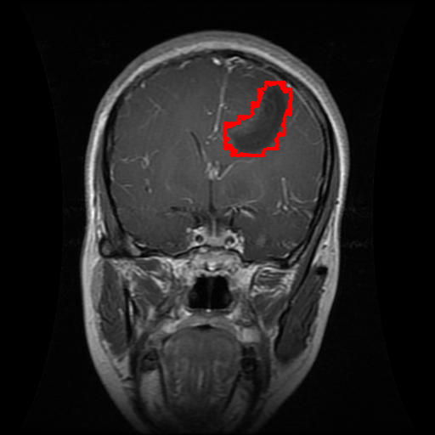
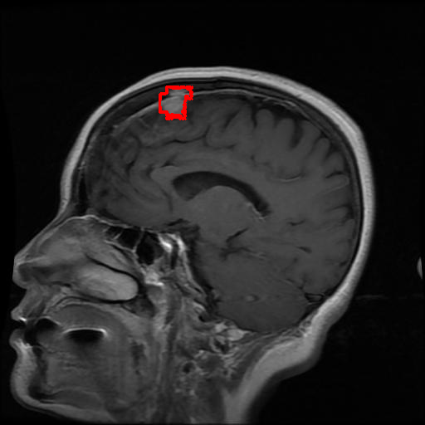
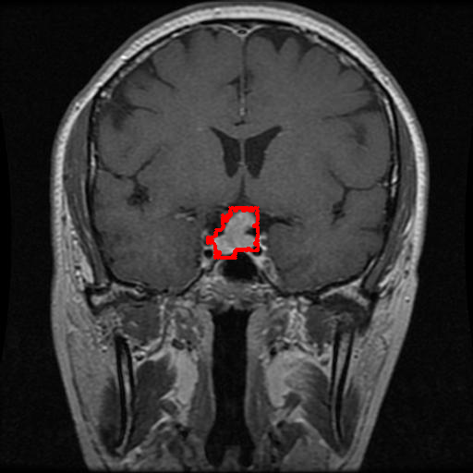
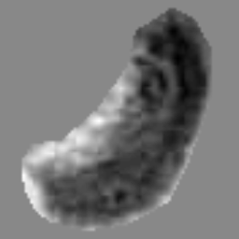
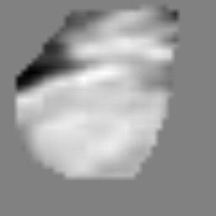
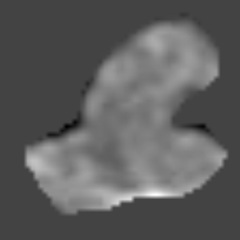
Preprocessed Images
4

Slide 9
Proposed Methodology
4
Deep Learning Model : ResNet-101
Residual learning can be easily interpreted as subtraction of input features learned from that layer.
This is done by ResNet using shortcut connections to each pair of 33 ﬁlters, directly connecting the input of kth layer to (k + x)th layer.
The motive behind bypassing layers is to keep away the problem of vanishing gradients by reutilizing activations from the preceding layer till the layer next to the present one has learned its weights.
While training the network, weights will amplify the layer next to the present one and will also adjust to mute the preceding layer.
ResNet-101 is 101-layer Residual Network and is a modiﬁed version of the 50-layer ResNet.

Slide 10
Block Diagram of Residual Module and SE-ResNet module
5
X
Residual
W x H x C
X
Global Pooling
1 x 1 x C
Fully Connected
1 x 1 x C/r
Residual
ReLU
1 x 1 x C/r
Fully Connected
1 x 1 x C
Sigmoid
1 x 1 x C
X̃
Scale
W x H x C
a) ResNet Module
W x H x C
X̃
b) SE-ResNet Module

Slide 11
Squeeze and Excitation block with ResNet
6
The input features X are ﬁrst passed through a squeeze operation with Max Pooling, which is used to average the feature maps in a spatial plane.
After this, two fully connected layers with ReLU and Sigmoid activations are used separately for excitation operation.
It was found that Squeeze and Excitation (SE) blocks combined with ResNet architecture, has performed outstandingly good in classifying the brain tumors. By stacking the SE blocks one after the other.

Slide 12
Training of Model
6
SE-ResNet-101 model was trained from scratch and ﬁnely tuned to just ﬁt training data, ﬁrst without data augmentation containing 3064 samples in total, and then using data augmentation which increased the data size to 7771.
The optimizer used for training purpose was Adam [20] with a learning rate of 0.005 at start and step by step reduced to 0.001, till it reaches the saturation.
At ﬁrst, the network was trained without data augmentation till 12,196 iterations and then with data augmentation, the pre-trained model was again trained for 13,898 iterations.
The total duration of training was 7 hours with a batch size of 5 for 26,094 iterations.

Slide 13
Experimental Results
6
The proposed model was trained on the original dataset for 20 epochs and after that, it was trained on the augmented dataset with pre-trained weights.
Performance Metrics used for Evaluations are:
Categorical Accuracy i.e Accuracy
Speciﬁcity
Sensitivity
Cross-entropy loss
The presented model had the overall accuracy of 93.83%, speciﬁcity of 0.9715 and sensitivity of 0.9384 respectively.

Slide 14
Experimental Results
6

Slide 15
Comparison of Proposed Method
6

Slide 16
Conclusion
7
A deep CNN based SE-ResNet-101 architecture is proposed for the automatic classification of brain tumor MR images into 3 classes: Gliomas, Meningioma, and Pituitary tumor.
Furthermore, experimental outcomes show that the proposed technique can provide a significant improvement in terms of overall accuracy, sensitivity, and specificity which significantly outperformed the other two recent competitive brain tumor classification techniques.
We believe that this proposed method may be used as a handy tool to doctors for brain tumor classification.
It may also be applicable to the other usages, such as liver lesion classification, breast tumor classification, etc.

Slide 17
Future Scope
8
The proposed model's future extension may include enhancement of the CNN based architecture to three-dimensional data provided by MRI outputs as well as covering a greater number of classes.

Slide 18
References
9
[1] J. Hu, L. Shen and G. Sun, “Squeeze-and-excitation networks,” in IEEE Conf. on CVPR 2018, pp. 7132-7141, 2018.
[2] K. He, X. Zhang, S. Ren, and J. Sun., “Deep residual learning for image recognition,” in Conf. on CVPR 2016, pp. 770-778, 2016.
[3] J. Cheng, et. al, “Enhanced Performance of Brain Tumor Classification via Tumor Region Augmentation and Partition,” in PloS one, vol. 10(12), 2015.
[4] J. S. Paul, A. J. Plassard, B. A. Landman, and D. Fabbri, “Deep learning for brain tumor classification,” in Proc. SPIE 10137, Medical Imaging 2017: Biomedical Applications in Molecular, Structural, and Functional Imaging, vol. 1013710, pp. 10137-16, 2017.
[5] J. Cheng, ``Brain tumor dataset''. figshare, 02-Apr-2017 [Online]. Available: https://figshare.com/articles/brain_tumor_dataset/1512427/5. [Accessed: 24-Dec-2018]

